Slide 1





PAIO: General, Portable I/O Optimizations with Minor Application Modifications
Ricardo Macedo¹, Yusuke Tanimura², Jason Haga², Vijay Chidambaram³, José Pereira¹, João Paulo¹
¹ INESC TEC and University of Minho, ² AIST, ³ UTAustin and VMware Research

Slide 2











Data-centric systems
Data-centric systems have become an integral part of modern I/O stacks
Good performance for these systems often requires storage optimizations
Scheduling, caching, tiering, replication, …
Optimizations are implemented in sub-optimal manner

Slide 3











Data-centric systems
Data-centric systems have become an integral part of modern I/O stacks
Good p optimiz
Sche
erformance for these systems often requires storage
ations
duling, caching, tiering, replication, …
There is a better way to implement
I/O optimizations
Optimizations are implemented in sub-optimal manner

Slide 4




Challenge #1
Application
Tightly coupled optimizations
I/O optimizations are single purposed
Require deep understanding of the system’s internal operation model
Key-Value Store
I/O Scheduling
SILK [ATC19]
Caching
AC-Key [ATC20]
Require profound system refactoring
Limited portability across systems
Tiering
SpanDB [FAST21]
Checksumming
Dong et al. [FAST21]
File System

Slide 5


Challenge #1
Application
Tightly coupled optimizations
I/O optimizations are single purposed
Require deep understanding of the system’s internal operation model
SILK’s I/O Scheduler
Reduce tail latency spikes in RocksDB
Key-Value Store
I/O Scheduling
SILK [ATC19]
Caching
AC-Key [ATC20]
Controls the interference between foreground and background tasks
Require profound system refactoring
Limited portability across systems
Tiering
SpanDB [FAST21]
Checksumming
Dong et al. [FAST21]
Required changing several modules, such as background operation handlers, internal queuing logic, and thread pools
File System

Slide 6



Challenge #1
Application
Decoupled optimizations
I/O optimizations should be disaggregated from the internal logic
Key-Value Store
I/O Scheduling
SILK [ATC19]
Caching
AC-Key [ATC20]
Tiering
SpanDB [FAST21]
Checksumming
Dong et al. [FAST21]
Moved to a dedicated I/O layer
Generally applicable
Portable across different scenarios
Dedicated I/O layer
I/O Scheduling Caching
Tiering Checksumming
File System

Slide 7




Challenge #2
Application
Rigid interfaces
Decoupled optimizations lose granularity and internal application knowledge
Key-Value Store
foreground flows
I/O layers communicate through rigid interfaces
compaction flows
flush flows
Discard information that could be used to classify and differentiate requests
File System

Slide 8






Challenge #2
Application
1
Key-value store operation
Rigid interfaces
Decoupled optimizations lose granularity and internal application knowledge
Workflow ID:
75476
Operation type:
read
Key-Value Store
foreground flows
Operation size:
4096
2
Key-value store operation
I/O layers communicate through rigid interfaces
Workflow ID:
75482
compaction flows
flush flows
Operation type:
write
Operation size:
4096
Discard information that could be used to classify and differentiate requests
3
Key-value store operation
File System
Workflow ID:
75490
Operation type:
read
Operation size:
4096

Slide 9



Challenge #2
1
Key-value store operation
Application
Information propagation
Application-level information must be propagated throughout layers
Workflow ID:
75476
Operation type:
read
Operation size:
4096
Key-Value Store
foreground flows
Context: foreground task
2
Key-value store operation
Decoupled optimizations can provide the same level of control and performance
Workflow ID:
75482
Operation type: write
Operation size:
Context: flush
4096
compaction flows
flush flows
3
Key-value store operation
Workflow ID:
75490
File System
Operation type:
read
Operation size:
4096
Context:
compaction L1-L2

Slide 10
PAIO
User-level framework for building portable and generally applicable optimizations
Adopts ideas from Software-Defined Storage
I/O optimizations are implemented outside applications as data plane stages
Stages are controlled through a control plane for coordinated access to resources
Enables the propagation of application-level information through context propagation
Porting I/O layers to use PAIO requires none to minor code changes

Slide 11
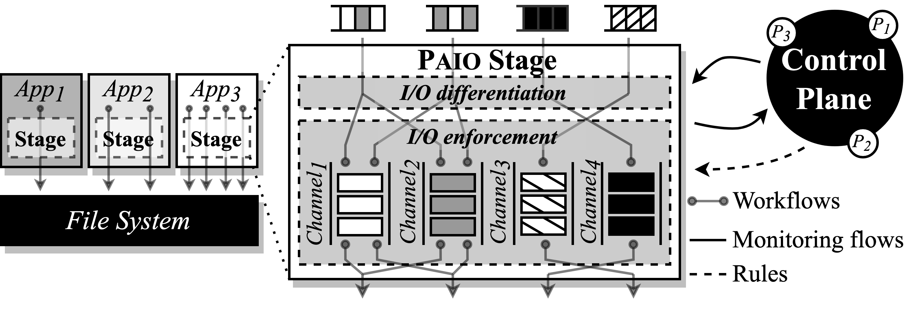
PAIO Design
Decoupled design that separated policies(control plane) and mechanisms(stage)
Stage routes all requests to PAIO before submitted to the file system
Main components
I/O differentiation
I/O enforcement
Control plane

Slide 12
I/O Differentiation
Classify and differentiate requests based on context
Context: an object that contains metadata for I/O request
Context propagation to exploit application-level information(optimal)
Minor code change is required

Slide 13
I/O Enforcement
Provide the building block for developing the actual I/O mechanisms
Composed of several channels, each containing one or more enforcement objects
Enforcement object: a mechanism that applies custom I/O logic over incoming requests

Slide 14
Control Plane
Continuously monitor and fine-tune the data plane stage using rules
Housekeeping / Differentiation / Enforcement rules
Provide global visibility to ensure stages are controlled holistically

Slide 15
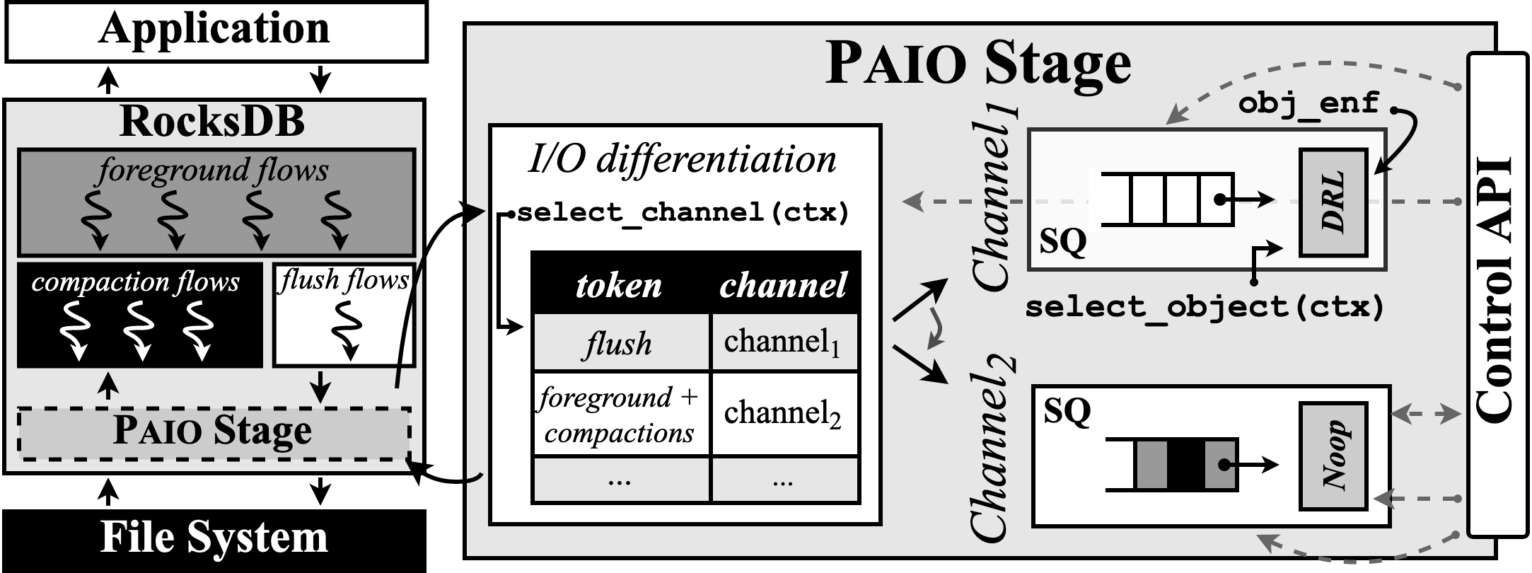
PAIO example
Policy: limit the rate of RocksDB’s flush operations to X MiB/s

Slide 16

I/O differentiation
Identify the origin of POSIX operations (i.e.,
foreground, compaction, or flush operations)

Slide 17

I/O differentiation
Context {
workflow-id : 75756, type : write,
context : flush,
size : 4096,
…
}

Slide 18
I/O differentiation
Dynamic Rate Limiter
Context {
workflow-id : 75756, type : write,
context : flush,
size : 4096,
…
}

Slide 19

I/O enforcement
PAIO currently supports Noop
and DRL enforcement objects

Slide 20

I/O enforcement
Requests return to their original I/O path

Slide 21

Control plane interaction
Differentiation rules
Housekeeping rules
Statistic collection
Enforcement rules
Implements the control algorithms for orchestrating stages (e.g., tail latency control, per-application bandwidth guarantees)

Slide 22
Tail Latency Control in LSM-based Key-Value Stores
RocksDB
•
•
Interference between foreground and background tasks generates high latency spikes Latency spikes occur due to L0-L1 compactions and flushes being slow or on hold
SILK(ATC '19)
I/O scheduler
•
•
•
Allocates bandwidth for internal operations when client load is low Prioritizes flushes and low level compactions
Preempts high level compactions with low level ones
Required changing several core modules made of thousands of LoC
PAIO
Stage provides the I/O mechanisms for prioritizing and rate limiting background flows
Integrating PAIO in RocksDB only required adding 85 LoC
Control plane provides a SILK-based I/O scheduling algorithm

Slide 23
Tail Latency Control in LSM-based Key-Value Stores
RocksDB
•
•
Interference between foreground and background tasks generates high latency spikes Latency spikes occur due to L0-L1 compactions and flushes being slow or on hold
SILK
I/O scheduler
•
•
•
Allocates bandwidth for internal operations when client load is low Prioritizes flushes and low level compactions
Preempts high level compactions with low level ones
•
Required changing several core modules made of thousands of LoC
PAIO
•
Stage provides the I/O mechanisms for prioritizing and rate limiting background flows
•
Integrating PAIO in RocksDB only required adding 85 LoC
•
Control plane provides a SILK-based I/O scheduling algorithm

Slide 24
Tail Latency Control in LSM-based Key-Value Stores
RocksDB
•
•
Interference between foreground and background tasks generates high latency spikes Latency spikes occur due to L0-L1 compactions and flushes being slow or on hold
SILK
I/O scheduler
By propagating application-level information to the stage, PAIO can enable similar control and performance as system-specific optimizations
• Allocates bandwidth for internal operations when client load is low
• Prioritizes flushes and low level compactions
• Preempts high level compactions with low level ones
•
Required changing several core modules made of thousands of LoC
PAIO
•
Stage provides the I/O mechanisms for prioritizing and rate limiting background flows
•
Integrating PAIO in RocksDB only required adding 85 LoC
•
Control plane provides a SILK-based I/O scheduling algorithm

Slide 25
Experimental setup
System configuration
•
•
•
•
RocksDB, SILK, and PAIO 8 client threads
8 background threads: 1 flush and 7 compaction threads Memory usage limited to 1GB and I/O bandwidth to 200MB/s
Workloads
•
•
•
•
Bursty clients (peaks and valleys) Initial valley of 300s at 5 KOps/s
100s peaks at 20 KOps/s and 10s valleys at 5 KOps/s Mixture, read-heavy, and write-heavy workloads

Slide 26
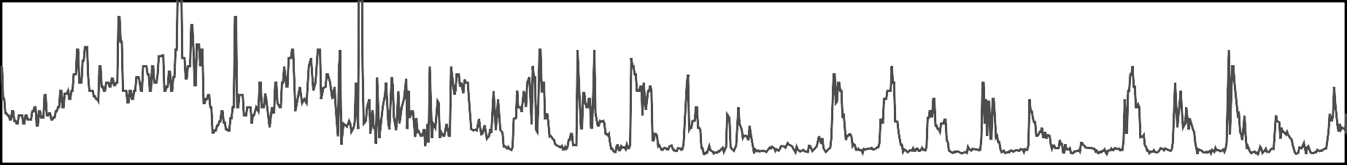

Mixture workload
50% read 50% write
Throughput
(KOps/s)
20
10
Latency
(ms)
20
15
10
5
RocksDB
Throughput
(KOps/s)
20
10
SILK
Latency
(ms)
20
15
10
5
Throughput
(KOps/s)
20
10
PAIO
Latency
(ms)
20
15
10
5
0
300
600
Time (s)
900
11220000
0
300
600
Time (s)
900
1200
Throughput: high variability due to constant flushes and compactions
99th latency: high tail latency with peaks with an average range between 3 and 15 ms

Slide 27
Mixture workload
50% read 50% write
Throughput
(KOps/s)
20
10
 | RocksDB
Latency
(ms)
20
15
10
5
Throughput
(KOps/s)
20
10
Latency
(ms)
20
15
10
5
SILK
Throughput
(KOps/s)
20
10
PAIO
Latency
(ms)
20
15
10
5
0
300
600
Time (s)
900
11220000
0
300
600
Time (s)
900
1200
Throughput: suffers periodic throughput drops due to accumulated backlog
99th latency: low and sustained tail latency

Slide 28
Mixture workload
50% read 50% write
Throughput
(KOps/s)
20
10
 | RocksDB
Latency
(ms)
20
15
10
5
Throughput
(KOps/s)
20
10
 | SILK
Latency
(ms)
20
15
10
5
Throughput
(KOps/s)
20
10
Latency
(ms)
20
15
10
5
PAIO
0
300
600
Time (s)
900
1200
0
300
600
Time (s)
900
1200
1
200
PAIO and SILK observe a 4x decrease in absolute tail latency

Slide 29
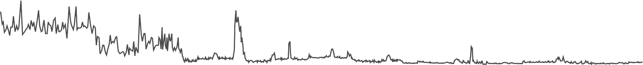
Read-heavy workload
90% read 10% write
Throughput
(KOps/s)
20
10
 | RocksDB
Latency
(ms)
20
15
10
5
Throughput
(KOps/s)
20
10
SILK
Latency
(ms)
20
15
10
5
Throughput
(KOps/s)
20
10
PAIO
Latency
(ms)
20
15
10
5
0
300
600
Time (s)
900
11220000
0
300
600
Time (s)
900
1200
99th latency: temporary performance degradation due to accumulated backlog

Slide 30
Read-heavy workload
90% read 10% write
Throughput
(KOps/s)
20
10
 | RocksDB
Latency
(ms)
20
15
10
5
Throughput
(KOps/s)
20
10
 | SILK
Latency
(ms)
20
15
10
5
Throughput
(KOps/s)
20
10
PAIO
Latency
(ms)
20
15
10
5
0
300
600
Time (s)
900
11220000
0
300
600
Time (s)
900
1200
99th latency: after 400s, SILK preempts high level compactions, achieving a tail latency between 1-2ms

Slide 31
Read-heavy workload
90% read 10% write
Throughput
(KOps/s)
20
10
 | RocksDB
Latency
(ms)
20
15
10
5
Throughput
(KOps/s)
20
10
 | SILK
Latency
(ms)
20
15
10
5
Throughput
(KOps/s)
20
10
 | PAIO
Latency
(ms)
20
15
10
5
0
300
600
Time (s)
900
1200
0
300
600
Time (s)
900
1200
1
200
Sustained tail latency but higher than SILK, due to not preempting compactions

Slide 32

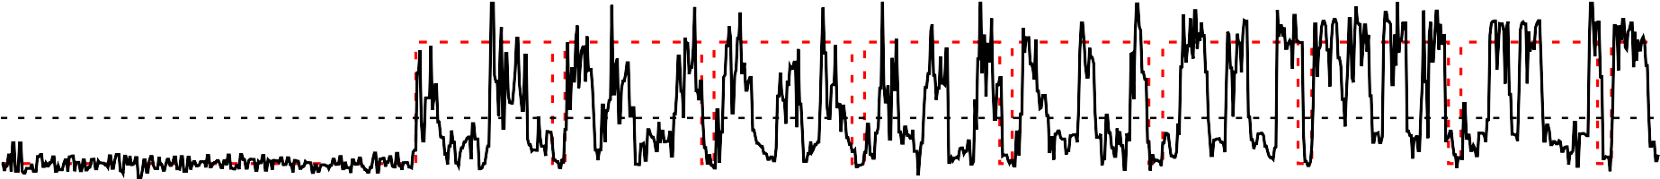
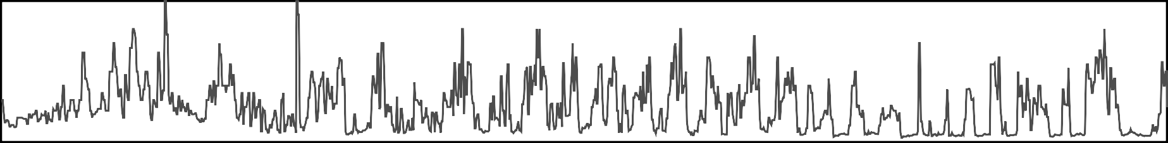

Write-heavy workload
10% read 90% write
Throughput
(KOps/s)
20
10
Latency
(ms)
20
15
10
5
RocksDB
Throughput
(KOps/s)
20
10
SILK
Latency
(ms)
20
15
10
5
Throughput
(KOps/s)
20
10
Latency
(ms)
20
15
10
5
PAIO
0
300
600
Time (s)
900
11220000
0
300
600
Time (s)
900
1200
Throughput: large backlog of background tasks leads to high throughput variability
99th latency: high latency spikes throughout the entire execution

Slide 33
Write-heavy workload
10% read 90% write
Throughput
(KOps/s)
20
10
 | RocksDB
Latency
(ms)
20
15
10
5
Throughput
(KOps/s)
20
10
SILK
Latency
(ms)
20
15
10
5
Throughput
(KOps/s)
20
10
Latency
(ms)
20
15
10
5
PAIO
0
300
600
Time (s)
900
11220000
0
300
600
Time (s)
900
1200
Throughput: suffers periodic throughput drops due to constant flushes
99th latency: SILK pauses high level compactions and only serves high priority operations

Slide 34
Write-heavy workload
10% read 90% write
Throughput
(KOps/s)
20
10
 | RocksDB
Latency
(ms)
20
15
10
5
Throughput
(KOps/s)
20
10
SILK
Latency
(ms)
20
15
10
5
Throughput
(KOps/s)
20
10
Latency
(ms)
20
15
10
5
PAIO
0
300
600
Time (s)
900
1200
0
300
600
Time (s)
900
1200
1
200
Since flushes occur more frequently, PAIO slows down high level compactions more aggressively, temporarily halting low level ones

Slide 35
Summary
PAIO, a user-level framework that enables system designers to build custom-made data plane stages
Combines ideas from Software-Defined Storage and context propagation
Decouples system-specific optimizations to dedicated I/O layers Data plane stages
Tail latency control in LSM-based KVS (RocksDB)
Per-application bandwidth control in shared storage settings (TensorFlow)
Enables similar control and I/O performance as system-specific optimizations

Slide 36

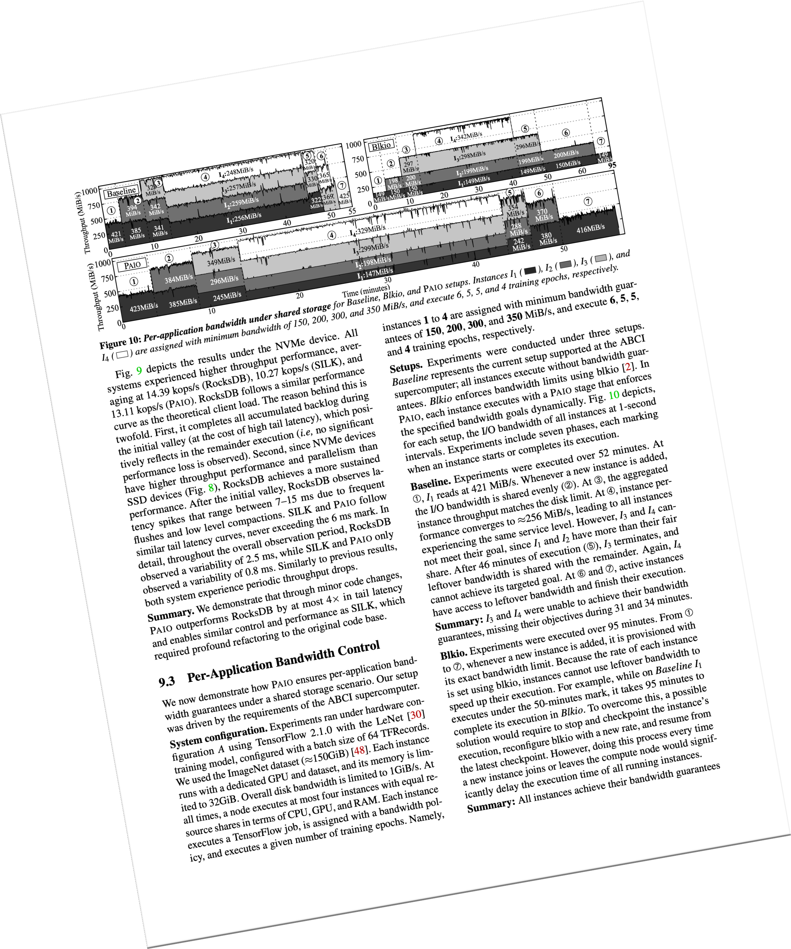

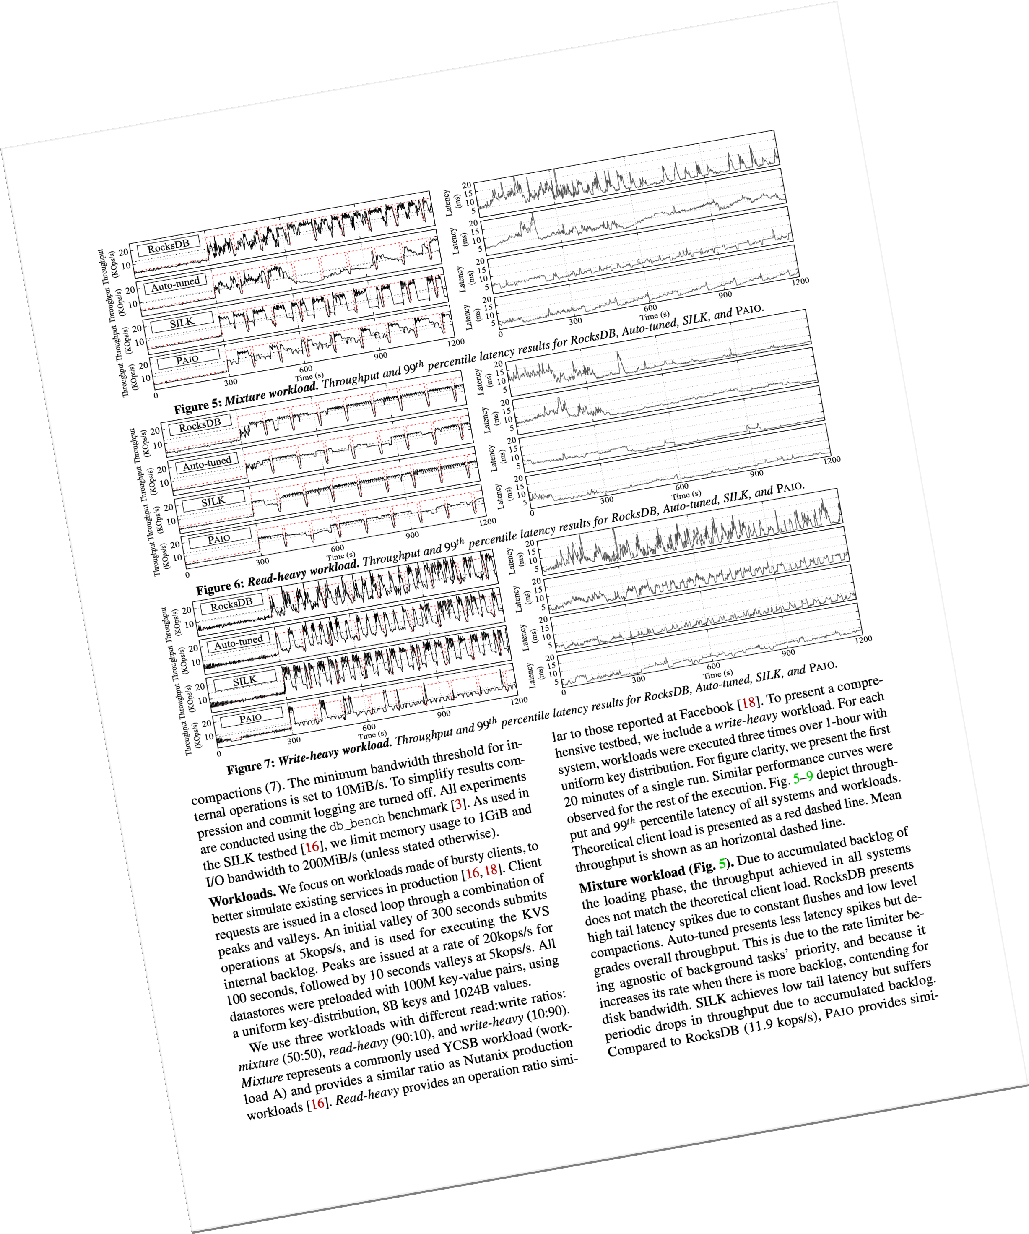
Paper
Data plane stages built with PAIO
Tail latency control in key-value stores (RocksDB)
Per-application bandwidth control (TensorFlow)
You can build your’s too!
Experiments
Performance and scalability
Profiling
Mixture workload without rate limiting
Per-application bandwidth results
PAIO is publicly available at dsrhaslab/paio

Slide 37
PAIO: General, Portable I/O Optimizations with Minor Application Modifications
Ricardo Macedo¹, Yusuke Tanimura², Jason Haga², Vijay Chidambaram³, José Pereira¹, João Paulo¹
¹ INESC TEC and University of Minho, ² AIST, ³ UTAustin and VMware Research

